Slide 1
Hardware Interface Control Document
Sparton Inertial Products

Slide 2
Introduction
Introduction
This document serves as the hardware interface control document for the Sparton Inertial Sensor line of product. When integrating a sensor for the first time, it can be cumbersome to a user to have to search for all of the documents related to the hardware design. This guide will show you how to align the system for the best accuracy and what the calibration reference(s) are in each product.
AHRS-8 / GEDC-6E / DC-4E
Layout
AHRS-8 / GEDC-6E / DC-4E
Connections
AHRS-8P / GEDC-6EP / DC-4EP
Layout
AHRS-8P / GEDC-6EP / DC-4EP
Connections
IMU-10
Layout
IMU-10
Connections

Slide 3
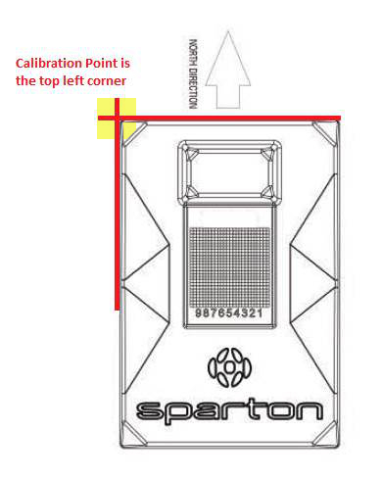
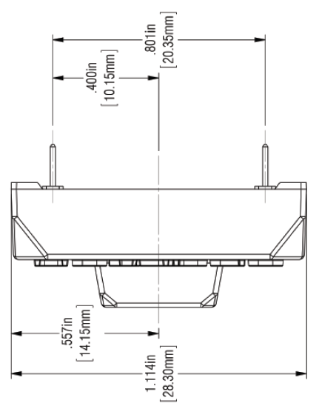
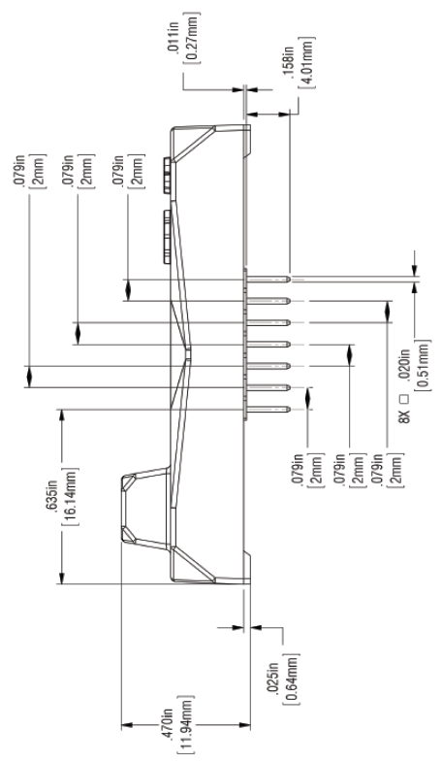
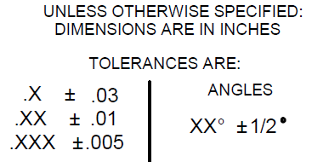
AHRS-8 / GEDC-6E / DC-4E Layout
Introduction
The OEM mounting option for Sparton’s DC-4E, GEDC-6E and AHRS-8 inertial systems provides accurate installation referenced to the top left corner of the ABS housing.
AHRS-8 / GEDC-6E / DC-4E
Layout
AHRS-8 / GEDC-6E / DC-4E
Connections
AHRS-8P / GEDC-6EP / DC-4EP
Layout
AHRS-8P / GEDC-6EP / DC-4EP
Connections
IMU-10
Layout
IMU-10
Connections

Slide 4
AHRS-8 / GEDC-6E / DC-4E Connections
Introduction
Mating Connectors
J1: Samtec, Part Number: TMM-107-03-G-S-004
J2: Samtec, Part Number: TMM-107-03-G-S
Digital Interface
Connections
AHRS-8 / GEDC-6E / DC-4E
Layout
AHRS-8 / GEDC-6E / DC-4E
Connections
Parameter | Conditions | Typical | Units
UART | 8 Data Bits, 1 Stop Bit No Parity | 115.2K Factory Default | Baud
 |  | 300 – 115.2K
UART: USER_RXD, DEBUG_RXD | Input | Logic 0: 0 | V
 |  | Logic 1: 3.3
UART: USER_TXD, DEBUG_TXD | Output | Logic 0: 0 | V
 |  | Logic 1: 3.3
AHRS-8P / GEDC-6EP / DC-4EP
Layout
AHRS-8P / GEDC-6EP / DC-4EP
Connections
IMU-10
Layout
Connector – Pin Number | Pin Name | I/O | Function
P1-1 | V_TEST | O | 3.3V regulator output for test purposes (factory use only)
P1-2 | DEBUG_RXD | I | 3.3V logic RXD Input to Debug Port (factory use only)
P1-3 | DEBUG_TXD | O | 3.3V logic TXD Output from Debug Port (factory use only)
P1-4 |  | N/A | pin removed for keying
P1-5 | #WP_EEPROM | I | 3.3V logic, active-low EEPROM write protect (the pin has 10kΩ pull-down)
P1-6 | Factory Use | I | Do not connect (factory use only)
P1-7 | GND | N/A | System Ground
P2-1 | V+ | I | +4 to +10V DC power supply input. Max load = 80mA
P2-2 | USER_RXD | I | 3.3V logic RXD input to User Com Port
P2-3 | USER_TXD | O | 3.3V logic TXD output from User Com Port
P2-4 | #RESET | I | 3.3V logic, active-low reset input (the pin has a weak pull-up)
P2-5 | #EINT0 | I | 3.3V logic, active-low interrupt input (the pin has a weak pull-up). Used for programming purposes
P2-6 | GND | N/A | System Ground
P2-7 | GND | N/A | System Ground
IMU-10
Connections

Slide 5
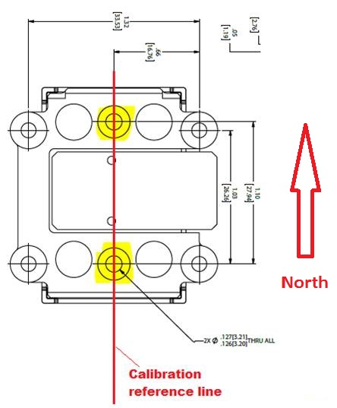
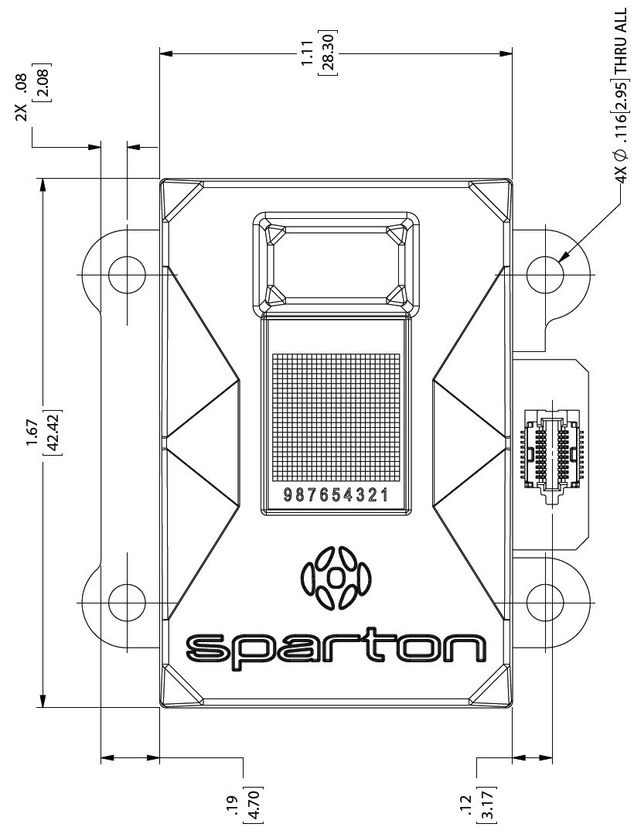
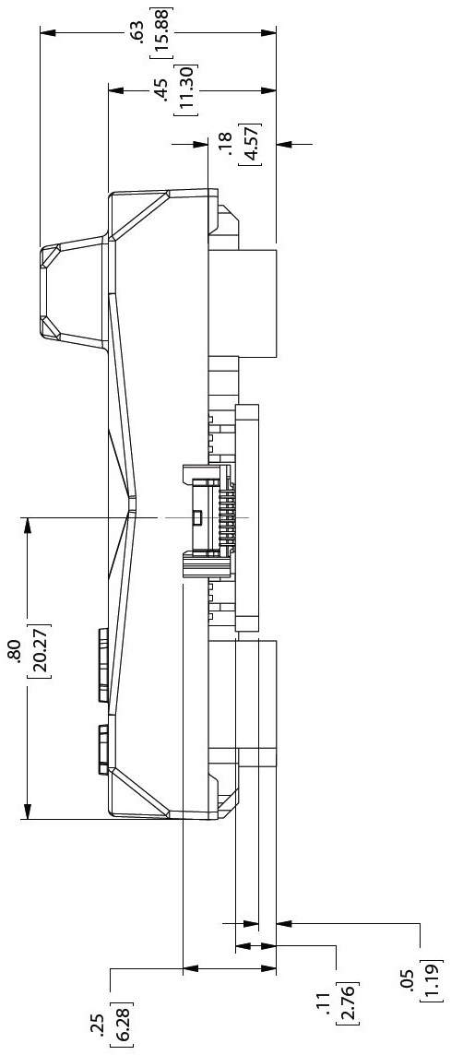
AHRS-8P / GEDC-6EP / DC-4EP Layout
Introduction
The precision mounting option for Sparton’s DC-4E, GEDC-6E and AHRS-8 inertial systems provide accurate installation and alignment within the end product and reduces the need for installation specific bore-sight adjustments. The compact high-density surface mount cable connection to the inertial system eliminates the need for a custom interface PCB.
AHRS-8 / GEDC-6E / DC-4E
Layout
AHRS-8 / GEDC-6E / DC-4E
Connections
AHRS-8P / GEDC-6EP / DC-4EP
Layout
AHRS-8P / GEDC-6EP / DC-4EP
Connections
IMU-10
Layout
IMU-10
Connections

Slide 6
AHRS-8P / GEDC-6EP / DC-4EP Connections
Introduction
Mating Connector
SAMTEC - ST4-10-1.00-L-D-P-TR
Digital Interface
Connections
AHRS-8 / GEDC-6E / DC-4E
Layout
AHRS-8 / GEDC-6E / DC-4E
Connections
Parameter | Conditions | Typical | Units
UART | 8 Data Bits, 1 Stop Bit, No Parity | 115.2K Factory Default | Baud
 |  | 300 – 115.2K
UART: USER_RXD, DEBUG_RXD | Input | Logic 0: 0 | V
 |  | Logic 1: 3.3
UART: USER_TXD, DEBUG_TXD | Output | Logic 0: 0 | V
 |  | Logic 1: 3.3
AHRS-8P / GEDC-6EP / DC-4EP
Layout
AHRS-8P / GEDC-6EP / DC-4EP
Connections
IMU-10
Layout
Connector – Pin Number | Pin Name | I/O | Function
1 | V+ | I | +4 to +10V DC power supply input. Max load = (80mA (AHRS-8), 80mA, (GEDC-6EP), 33mA (DC-4EP))
2 | V+ | I | +4 to +10V DC power supply input. Max load = (80mA (AHRS-8), 80mA, (GEDC-6EP), 33mA (DC-4EP))
3 | USER_RXD | I | 3.3V logic RXD input to User Com Port
4 | USER_RXD | I | 3.3V logic RXD input to User Com Port
5 | USER_TXD | O | 3.3V logic TXD output from User Com Port
6 | USER_TXD | O | 3.3V logic TXD output from User Com Port
7 | /RESET | I | 3.3V logic, active-low reset input (the pin has a weak pull-up)
8 | /RESET | I | 3.3V logic, active-low reset input (the pin has a weak pull-up)
9 | /EINT0 | I | 3.3V logic, active-low interrupt input (the pin has a weak pull-up). Used for programming purposes
10 | /EINT0 | I | 3.3V logic, active-low interrupt input (the pin has a weak pull-up). Used for programming purposes
11 | GND | N/A | System Ground
12 | GND | N/A | System Ground
13 | V_TEST | O | 3.3V regulator output for test purposes (factory use only)
14 | V_TEST | O | 3.3V regulator output for test purposes (factory use only)
15 | DEBUG_RXD | I | 3.3V logic RXD Input to Debug Port (factory use only)
16 | DEBUG_RXD | I | 3.3V logic RXD Input to Debug Port (factory use only)
17 | DEBUG_TXD | O | 3.3V logic TXD Output from Debug Port (factory use only)
18 | DEBUG_TXD | O | 3.3V logic TXD Output from Debug Port (factory use only)
19 | #WP_EEPROM | I | 3.3V logic, active-low EEPROM write protect (the pin has 10kΩ pull-down)
20 |  |  | Reserved
IMU-10
Connections

Slide 7
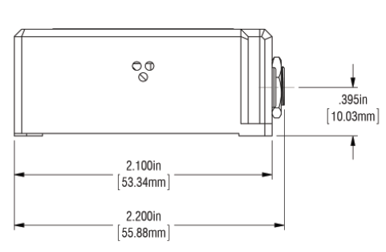
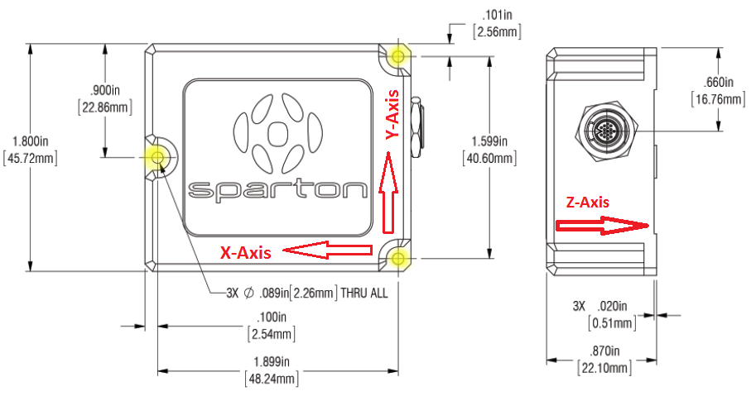
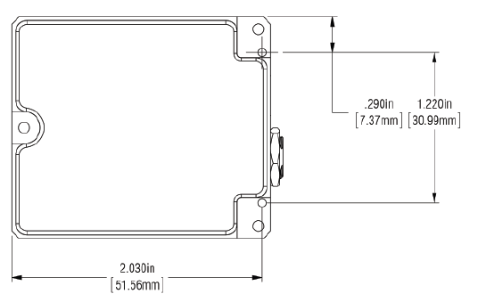
IMU-10 Layout
Introduction
The mounting for Sparton’s IMU-10 inertial system provides accurate installation and alignment within the end product. The Sparton IMU-10 inertial sensing system thrives in such environments and provides the end user with a reliable high-performance, high-accuracy 10 DOF inertial sensing package in a ruggedized enclosure. The X/Y/Z follow the North-East-Down convention for Navigation Systems.
AHRS-8 / GEDC-6E / DC-4E
Layout
AHRS-8 / GEDC-6E / DC-4E
Connections
AHRS-8P / GEDC-6EP / DC-4EP
Layout
AHRS-8P / GEDC-6EP / DC-4EP
Connections
IMU-10
Layout
IMU-10
Connections

Slide 8
IMU-10 Connections
Introduction
Mating Connector
Omnetic - A73869-801
Digital Interface
Connections
AHRS-8 / GEDC-6E / DC-4E
Layout
AHRS-8 / GEDC-6E / DC-4E
Connections
Parameter | Conditions | Typical | Units
UART | 8 Data Bits, 1 Stop Bit, No Parity | 921.6K Factory Default | Baud
 |  | 300 – 921.6K
UART: USER_RXD, E_GPS_RxD | Input | Logic 0: 0 | V
 |  | Logic 1: 3.3
UART: USER_TXD, E_GPS_TxD | Output | Logic 0: 0 | V
 |  | Logic 1: 3.3
AHRS-8P / GEDC-6EP / DC-4EP
Layout
AHRS-8P / GEDC-6EP / DC-4EP
Connections
IMU-10
Layout
Connector Pin # | Pin Name | I/O | Function
1 | VIN | I | Power supply input to sensor.
2 | VIN | I | Power supply input to sensor.
3 | User_TxD | O | 3.3V logic TxD output from Sensor User Com Port
4 | User_RxD | I | 3.3V logic RxD input to Sensor User Com Port
5 | Debug_TxD | O | 3.3V logic TxD output for Debug port
6 | Debug_RxD | I | 3.3V logic RxD input for Debug port
7 | GND | N/A | System Ground
8 | Reserved | Res | Reserved
9 | Reserved | Res | Reserved
10 | GPIO1 | I/O | General purpose I/O pin. See separate info for configuration options
11 | GND | N/A | System Ground
12 | SCLK | O | SPI Serial Clock
13 | /CS, Ser. Prog En | I/O | Dual purpose pin: Input: Serial Program Enable, pin is read at boot. High – normal operation, Low – Firmware upgrade mode. Output: Memory Card Chip Select (Negative logic).
14 | MOSI | O | SPI Serial Data Out
15 | MISO | I | SPI Serial Data In
16 | GPIO2 | I/O | General purpose I/O pin. See separate info for configuration options
IMU-10
Connections

